Slide 1
DAA PROJECT IMPLEMENTION
Module-:Program Level Ojective Setting
Submitted By : Team TECH TITANS
S.Revanth Sai - AP23110011112
T. Amruthaa - AP23110011142
K.Praneeth chandra - AP23110011166
K.Mokshagna - AP23110011110
K.Kiranmai - AP23110010716
SB.Navaneeth - AP23110011106
BTECH|CSE-P|SEMESTER-3|2023-27

Slide 2
Introduction to Project
The Course Objective Setting Module is an essential component of Outcome-Based Education (OBE). This module ensures that the course objectives are clearly defined, measurable, and aligned with the overall program goals. By establishing specific course objectives that are aligned with program-level outcomes, this module helps create a structured framework for ensuring that each course contributes effectively to the achievement of the program’s educational goals. This alignment forms the foundation for assessment strategies, curriculum design, and the continuous improvement process.

Slide 3
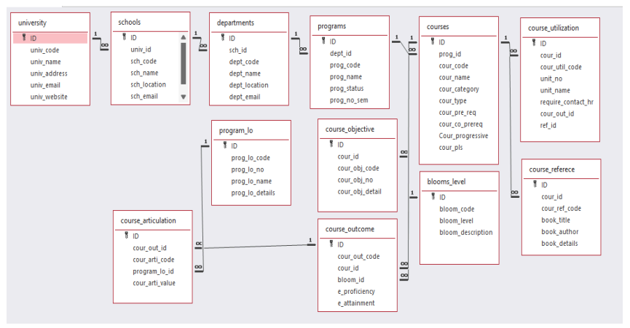

Architecture Diagram

Slide 4
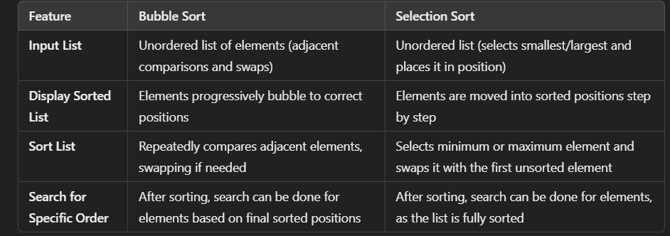
Module Description : Program Level Objective Setting
Module Description:
This module focuses on defining and structuring course objectives that are aligned with program-level goals. It provides a systematic approach for mapping these objectives to the broader program outcomes. By doing so, the module supports curriculum coherence and facilitates continuous improvement.
.

Slide 5
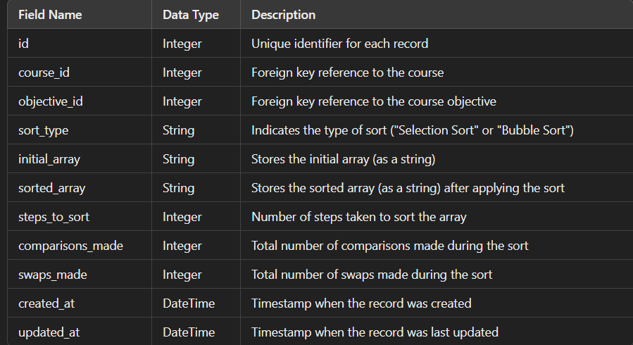
Field/table details: For Programs

Slide 6
Program level objective setting:Programming Details
File name:XXXXXXXXXXXXXXX.txt
Function/method name
Input: AP23110011142_Course_Matrix_input
Display: AP2311011112_Course_Matrix_display
Sort: AP23110011110_Course_Matrix_sort
Search: AP23110011079_Course_Matrix_search
Store: AP23110010716_Course_Matrix_store

Slide 7
Program_lo :Programming Details
Comparison (both Searching and Sorting):
For Searching - AP23110011166compare_searching_algorithms
For Sorting - AP23110011178_compare_sorting_algorithms
Time Complexity (both Searching and Sorting):
For Searching/Sorting - AP23110011198_display_time_complexity

Slide 8
Program_lo :Programming Details
Input: AP23110011185_Course_Matrix_input
Display: AP23110011185_Course_Matrix_display
Sort: AP23110011200_Course_Matrix_sort
Search: AP231100111200_Course_Matrix_search
Store: AP23110011200_Course_Matrix_store
Comparison:
Searching: AP23110011200_compare_searching_algorithms
Sorting: AP2311001153_compare_sorting_algorithms
Time Complexity:
Searching/Sorting: AP23110011153_display_time_complexity
Algorithm Details:
For Searching/Sorting: AP23110011153_display_pseudocode
File Name:
XXXXXXXXXXX.txt

Slide 9
Sorting Algorithm used
Start
Input matrix of size courses x outcomes
For i = 0 to courses - 1:
For j = i + 1 to courses:
Initialize sum_i = 0 and sum_j = 0
For k = 0 to outcomes - 1:
sum_i += matrix[i][k]
sum_j += matrix[j][k]
If sum_i > sum_j:
For k = 0 to outcomes - 1:
Swap matrix[i][k] and matrix[j][k]
Output sorted matrix
End

Slide 10
Sorting Algorithm used
Selection Sort :
Algorithm:
Step-1: Ask user to choose a field to sort by (code or name).
Step-2:loop from 0 to program_count-1
Step-3: set min_index = I
Step -4:loop from i+1 to program_count
Step-5: if programs[j]<program[j+1] then replace the values of min_index to j
Step-6: swap prorams[i] = programs[min_index]
Step-7: continue the program until complete array to be sorted
Step-8: print success message

Slide 11
Time Complexity of Sorting Algorithm
Sl.No | Algorithm Name | Complexity of Algorithm
01 | Bubble Sort | O(n^2)
02 | Selection Sort | O(n^2)

Slide 12
SORTED MATRIX ALGORITHM :
Start
Input matrix of size courses x outcomes
For i = 0 to courses - 1:
For j = i + 1 to courses:
Initialize sum_i = 0 and sum_j = 0
For k = 0 to outcomes - 1:
sum_i += matrix[i][k]
sum_j += matrix[j][k]
If sum_i > sum_j:
For k = 0 to outcomes - 1:
Swap matrix[i][k] and matrix[j][k]
Output sorted matrix
End

Slide 13
ALGORITHM FOR COURSE ARTICULATION:
Start
Identify the course to be articulated
Check if the course is in the articulation database
If course is in the database:
Retrieve existing articulation information
Else:
Evaluate the course content for equivalency
If course content is equivalent:
Update the articulation database with new information
Else:
Notify relevant stakeholders of the decision
End

Slide 14
Time Complexity of Searching Algorithm
Sl.No | Algorithm Name | Complexity of Algorithm
01 | Course articulation | O(k)
02 | Sorted matrix | O(kn^2)

Slide 15
Overview Code[overview of searching,Sorting,CRUD and Storage options]
// 1. CRUD Operations
void inputMatrix() { /* Create: Inputs new course articulation matrix */ }
void displayMatrix() { /* Read: Displays the course articulation matrix */ }
void sortMatrix() { /* Update: Sorts the course articulation matrix */ }
void searchCourse() { /* Read: Searches for a specific course articulation in the matrix */ }
// 2. Sorting (e.g., by sum of elements in rows)
void sortMatrix(int matrix[MAX_COURSES][MAX_OUTCOMES], int courses, int outcomes) {
// Sorts matrix rows based on the sum of their elements
for (int i = 0; i < courses - 1; i++) {
for (int j = i + 1; j < courses; j++) {
int sum_i = 0, sum_j = 0;
for (int k = 0; k < outcomes; k++) {
sum_i += matrix[i][k];
sum_j += matrix[j][k];
}
if (sum_i > sum_j) {
for (int k = 0; k < outcomes; k++) {
int temp = matrix[i][k];
matrix[i][k] = matrix[j][k];
matrix[j][k] = temp;
}
}
}
}
}

Slide 16
// 3. Searching (e.g., by course articulation)
int* searchCourse(int matrix[MAX_COURSES][MAX_OUTCOMES], int courses, int outcomes, int target[MAX_OUTCOMES]) {
for (int i = 0; i < courses; i++) {
int found = 1;
for (int j = 0; j < outcomes; j++) {
if (matrix[i][j] != target[j]) {
found = 0;
break;
}
}
if (found) {
return matrix[i]; // Return pointer to found course articulation
}
}
return NULL; // Not found
}

Slide 17
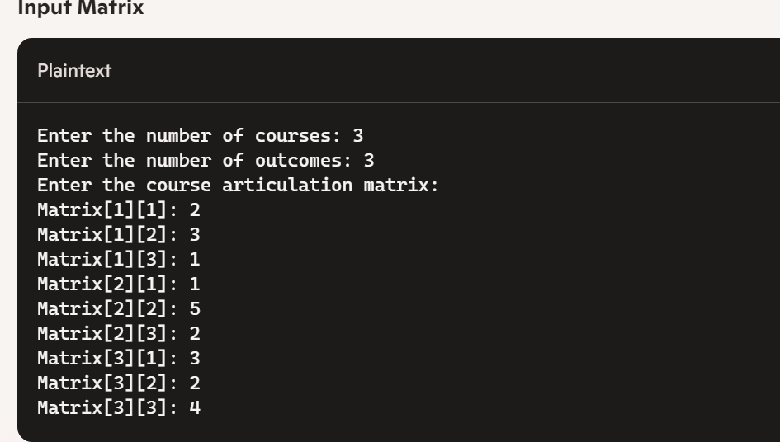
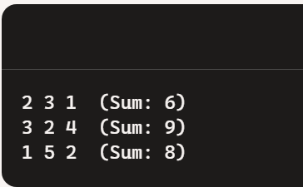
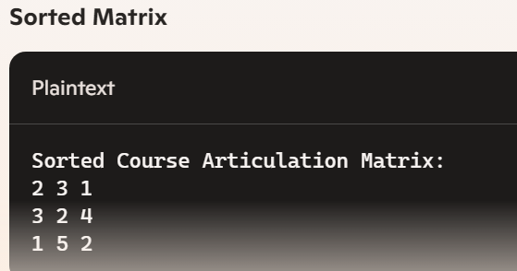
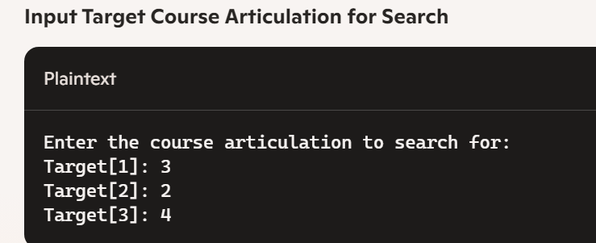
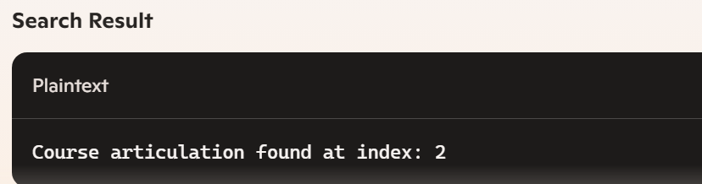
screenshots

Slide 18
Conclusion
In the programming section, we designed a comprehensive C program that handles a Course Articulation Matrix. This program includes functionalities for inputting the matrix, displaying it, sorting the courses based on specific criteria, and searching for a particular course articulation. We provided detailed steps to capture screenshots and explained how to document the code with an architecture diagram.
By implementing these concepts, you gained valuable insights into both discrete mathematics and practical programming, enhancing your problem-solving skills and ability to organize and present technical information effectively.

Slide 19


